Slide 1
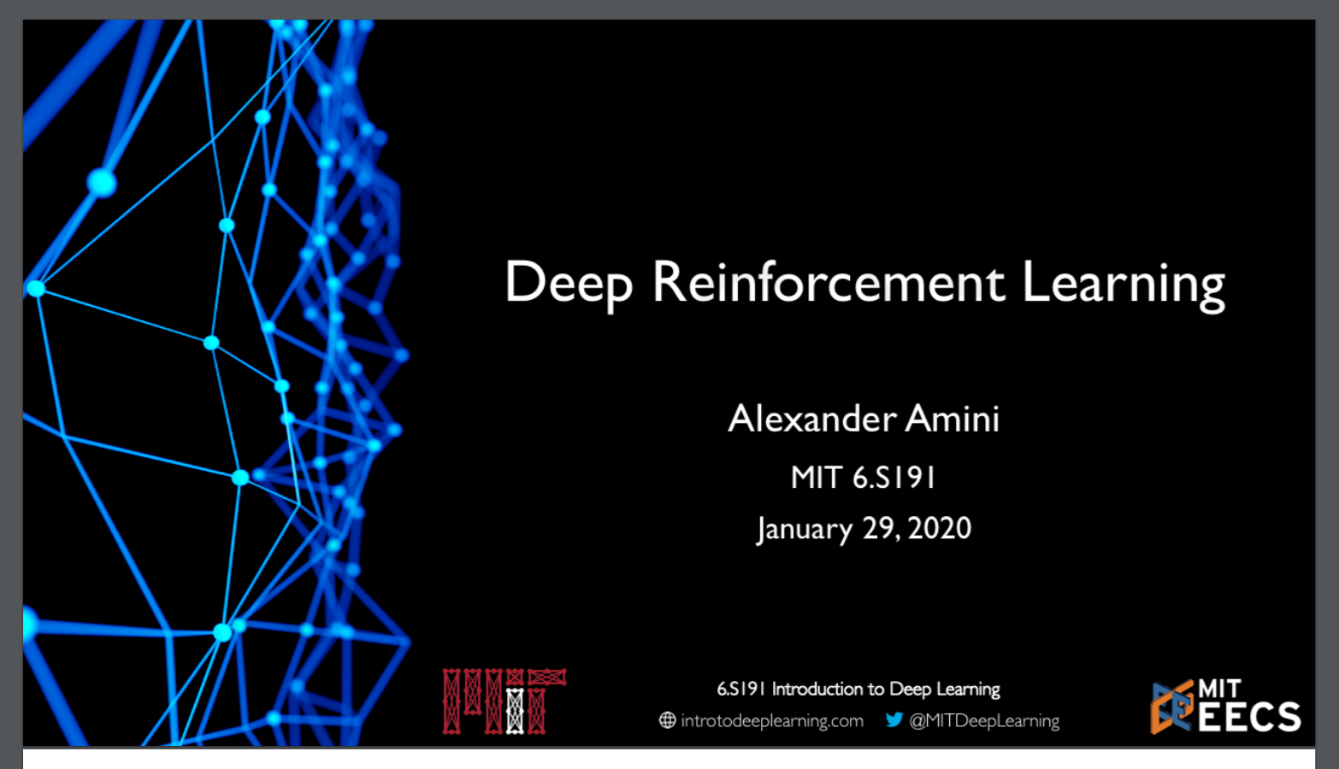

Slide 2
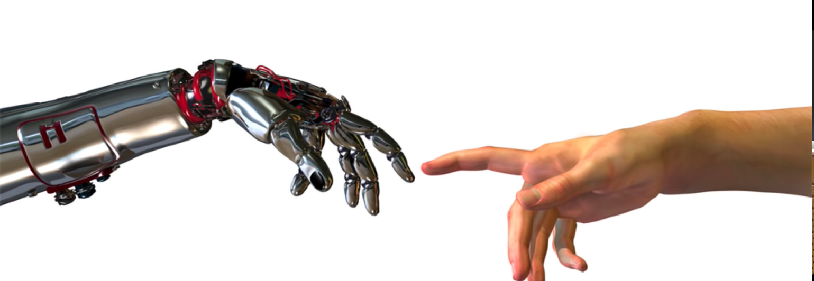
Learning in dynamic Environments

Slide 3
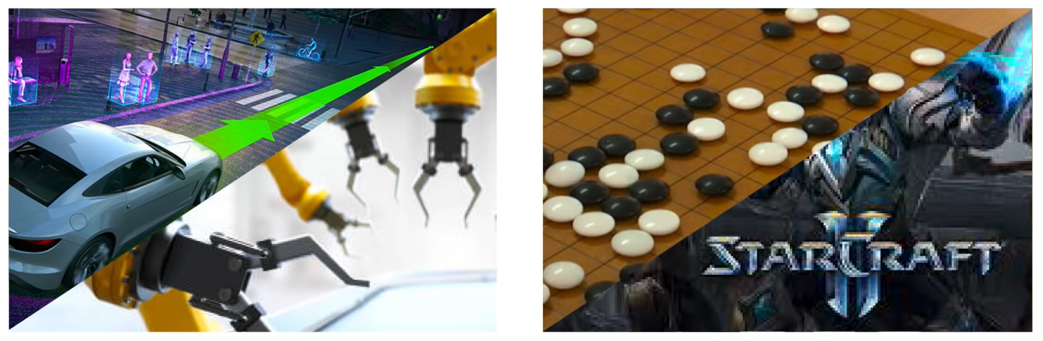
Reinforcement Learning: Robots, Games, the World
Robotics
Game Play and Strategy

Slide 4
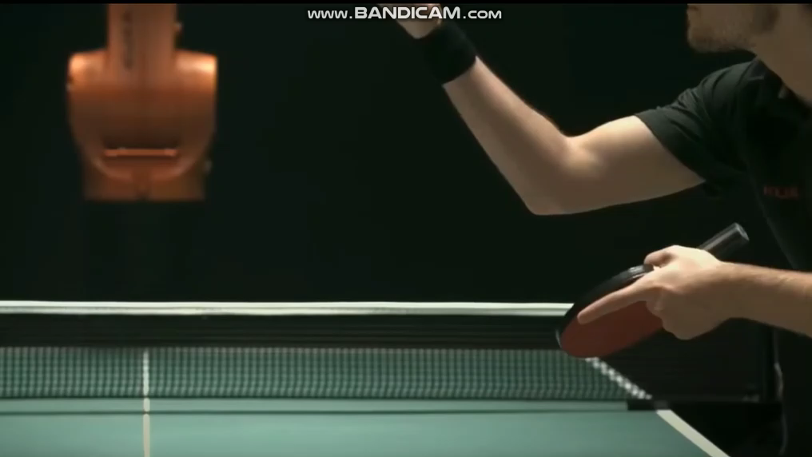

Slide 5

Classes of Learning Problems
Supervised Learning
Data: (x,y)
X is data, y is label
Goal: Learn function to map
x → y
Apple example:
This thing is an apple.

Slide 6

Classes of Learning Problems
Supervised Learning
Data: (x,y)
X is data, y is label
Goal: Learn function to map
x → y
Apple example:
Unsupervised Learning
Data: x
X is data, no labels
Goal: Learn underlying structure
Apple example:
This thing is an apple.
This thing is like the other thing.

Slide 7
Classes of Learning Problems
Supervised Learning
Data: (x,y)
X is data, y is label
Goal: Learn function to map
x → y
Apple example:
Unsupervised Learning
Data: x
X is data, no labels
Goal: Learn underlying structure
Apple example:
Reinforcement Learning
Data: state-action pairs
Goal: Maximize future rewards over many time steps
Apple example:
This thing is an apple.
This thing is like the other thing.
Eat this thing because it will keep you alive

Slide 8
Classes of Learning Problems
Supervised Learning
Data: (x,y)
X is data, y is label
Goal: Learn function to map
x → y
Apple example:
Unsupervised Learning
Data: x
X is data, no labels
Goal: Learn underlying structure
Apple example:
Reinforcement Learning
Data: state-action pairs
Goal: Maximize future rewards over many time steps
Apple example:
RL: our focus today
This thing is an apple.
This thing is like the other thing.
Eat this thing because it will keep you alive

Slide 9

Reinforcement Learning (RL): Key Concepts
AGENT
Agent: takes actions

Slide 10

Reinforcement Learning (RL): Key Concepts
AGENT
ENVIRONMENT
Environment: the world in which the agent exists and operates.

Slide 11
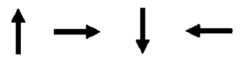

Reinforcement Learning (RL): Key Concepts
Action: $a_{t}$
AGENT
ENVIRONMENT
ACTIONS
Action: a move the agent can make in the environment
Action space A: the set of possible actions an agent can make in the environment

Slide 12
Reinforcement Learning (RL): Key Concepts
OBSERVATIONS
Action: $a_{t}$
AGENT
ENVIRONMENT
ACTIONS
Observations: of the environment after taking actions

Slide 13
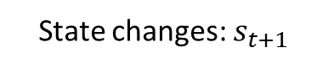
Reinforcement Learning (RL): Key Concepts
OBSERVATIONS
State changes: $s_{t+1}$
Action: $a_{t}$
AGENT
ENVIRONMENT
ACTIONS
State: a situation which the agent perceives.

Slide 14

Reinforcement Learning (RL): Key Concepts
OBSERVATIONS
State changes: $s_{t+1}$
Reward: $r_{t}$
Action: $a_{t}$
AGENT
ENVIRONMENT
ACTIONS
Reward: feedback that measure the success or failure of the agent’s action.

Slide 15
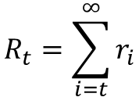
Reinforcement Learning (RL): Key Concepts
OBSERVATIONS
State changes: $s_{t+1}$
Reward: $r_{t}$
Action: $a_{t}$
AGENT
ENVIRONMENT
ACTIONS
Total Reward
(Return)
$$R_{t}=\sum_{i=t}^{∞}{r_{i}}$$

Slide 16
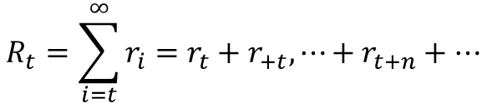
Reinforcement Learning (RL): Key Concepts
OBSERVATIONS
State changes: $s_{t+1}$
Reward: $r_{t}$
Action: $a_{t}$
AGENT
ENVIRONMENT
ACTIONS
Total Reward
(Return)
$$R_{t}=\sum_{i=t}^{∞}{r_{i}=r_{t}+r_{+t},⋯+r_{t+n}+…}$$

Slide 17
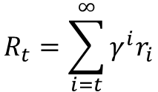
Reinforcement Learning (RL): Key Concepts
OBSERVATIONS
State changes: $s_{t+1}$
Reward: $r_{t}$
Action: $a_{t}$
AGENT
ENVIRONMENT
ACTIONS
Discounted Total Reward
(Return)
$$R_{t}=\sum_{i=t}^{∞}{{γ^{ⅈ}r}_{i}}$$

Slide 18
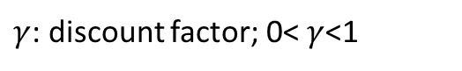
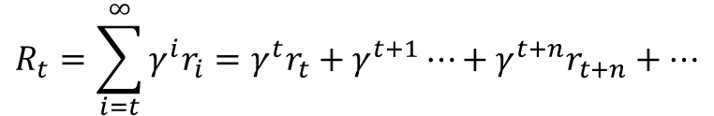
Reinforcement Learning (RL): Key Concepts
OBSERVATIONS
State changes: $s_{t+1}$
Reward: $r_{t}$
Action: $a_{t}$
AGENT
ENVIRONMENT
ACTIONS
Discounted Total Reward
(Return)
$$R_{t}=\sum_{i=t}^{∞}{{γ^{ⅈ}r}_{i}=γ^{t}r_{t}+γ^{t+1}⋯+γ^{t+n}r_{t+n}+⋯}$$
$γ$: discount factor; 0< $γ$<1

Slide 19
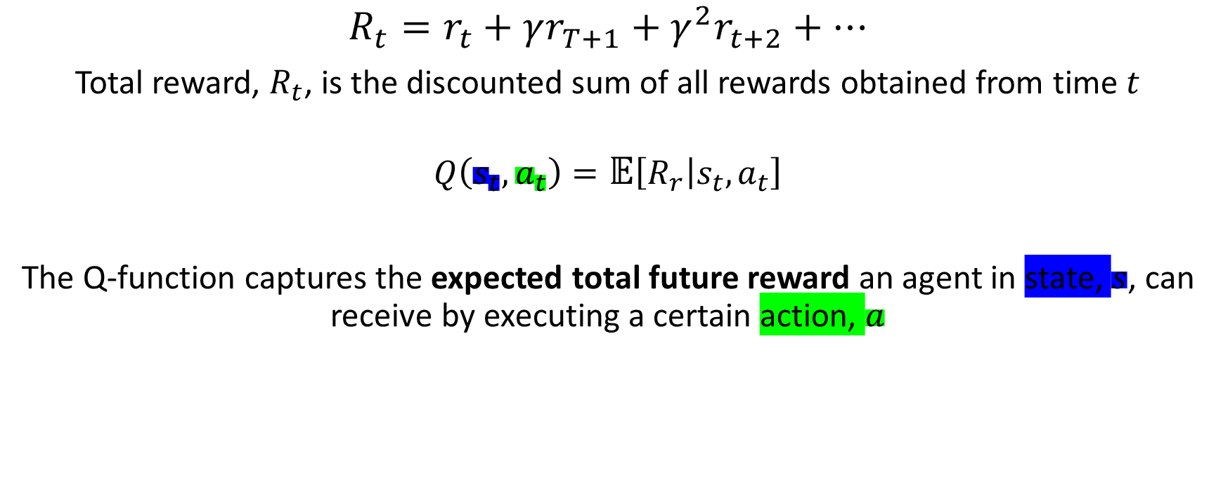
Defining the Q-function
$$R_{t}=r_{t}+γr_{T+1}+γ^{2}r_{t+2}+⋯$$
Total reward, $R_{t}$, is the discounted sum of all rewards obtained from time $t$
$$Q\left(s_{t},a_{t}\right)=\text{𝔼}\left[\left.R_{r}\right|s_{t},a_{t}\right]$$
The Q-function captures the expected total future reward an agent in state, $s$, can receive by executing a certain action, $a$

Slide 20
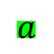
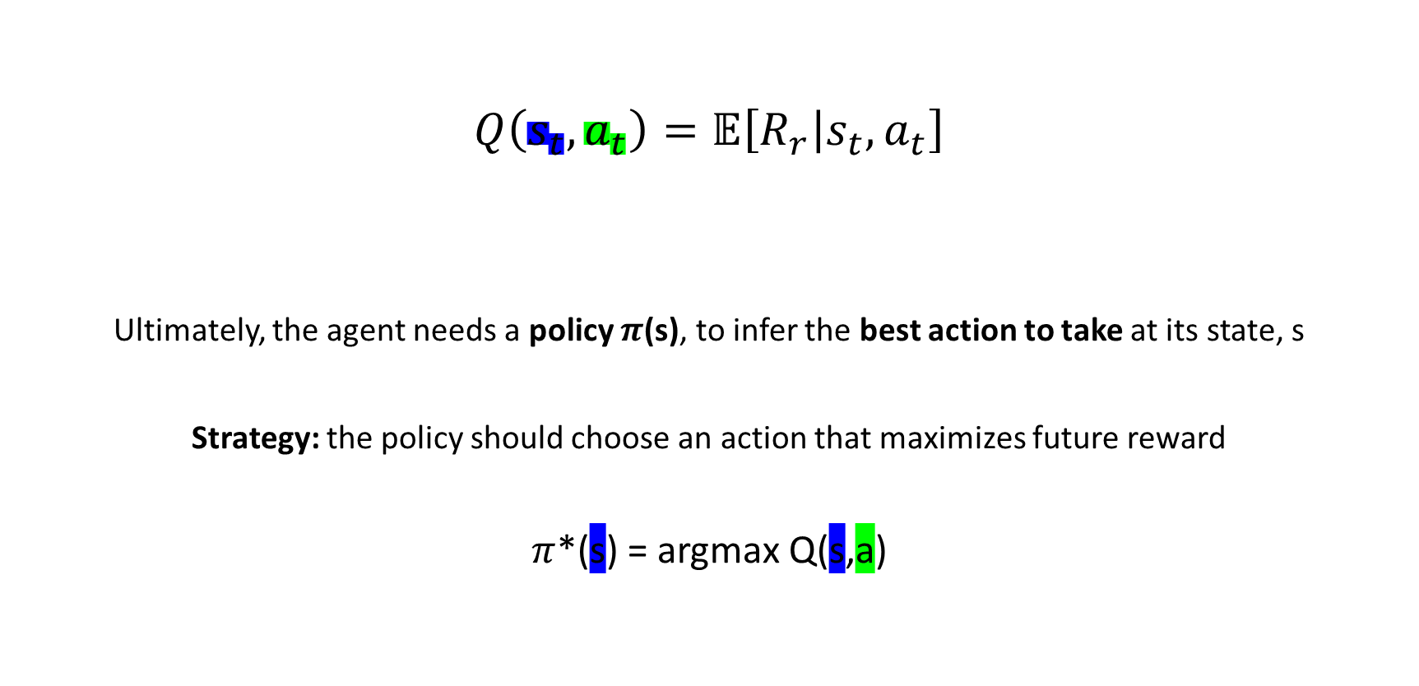
How to take actions given a Q-function?
$$Q\left(s_{t},a_{t}\right)=\text{𝔼}\left[\left.R_{r}\right|s_{t},a_{t}\right]$$
Ultimately, the agent needs a policy $π$(s), to infer the best action to take at its state, s
Strategy: the policy should choose an action that maximizes future reward
$π$*(s) = argmax Q(s,a)
(state, action)
$$a$$

Slide 21


Deep Reinforcement Learning Algorithms
Value Learning
Find $Q(s,a)$
$a$= argmax $Q(s,a)$
$$a$$
Value Learning
Find $π(s)$
Sample $a\sim π(s)$

Slide 22

Deep Reinforcement Learning Algorithms
Value Learning
Find $Q(s,a)$
$a$= argmax $Q(s,a)$
$$a$$
Value Learning
Find $π(s)$
Sample $a\sim π(s)$

Slide 23
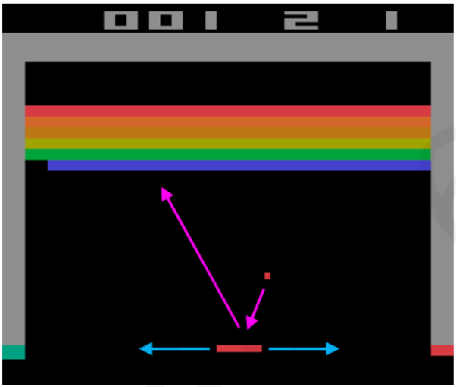
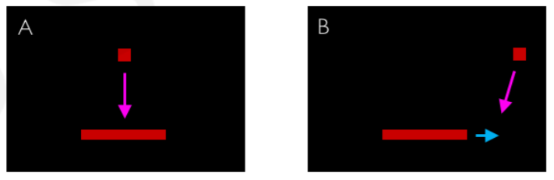

Digging deeper into the Q-function
Example: Atari Breakout
It can be very difficult for humans to accurately estimate Q-values
Which (s, a) pair has a higher Q-Value?

Slide 24

Digging deeper into the Q-function
Example: Atari Breakout - Middle
It can be very difficult for humans to accurately estimate Q-values
Which (s, a) pair has a higher Q-Value?

Slide 25
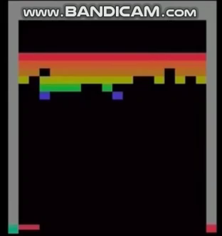
Digging deeper into the Q-function
Example: Atari Breakout - Side
It can be very difficult for humans to accurately estimate Q-values
Which (s, a) pair has a higher Q-Value?

Slide 26

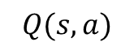


Deep Q Networks (DQN)
How can we use deep neural networks to model Q-functions?
Action + State → Expected Return
state, $s$
Deep
NN
$$Q(s,a)$$
“move
right”
action, $a$
Input
Agent
Output

Slide 27
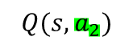

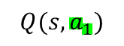
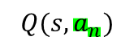
Deep Q Networks (DQN)
How can we use deep neural networks to model Q-functions?
Action + State → Expected Return
State → Expected Return for Each Action
$$Q(s,a_{1})$$
Deep
NN
Deep
NN
$$Q(s,a_{2})$$
state, $s$
$$Q(s,a)$$
“move
right”
state, $s$
$$Q(s,a_{n})$$
action, $a$
Input
Agent
Output
Input
Agent
Output

Slide 28

Deep Q Networks (DQN): Training
How can we use deep neural networks to model Q-functions?
Action + State → Expected Return
State → Expected Return for Each Action
$$Q(s,a_{1})$$
Deep
NN
Deep
NN
$$Q(s,a_{2})$$
state, $s$
$$Q(s,a)$$
“move
right”
state, $s$
$$Q(s,a_{n})$$
action, $a$
Input
Agent
Output
Input
Agent
Output
What happens if we take all the best actions?
Maximize target return → train the agent

Slide 29
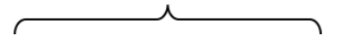

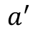
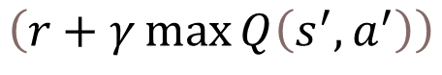
Deep Q Networks (DQN): Training
How can we use deep neural networks to model Q-functions?
Action + State → Expected Return
State → Expected Return for Each Action
$$Q(s,a_{1})$$
Deep
NN
Deep
NN
$$Q(s,a_{2})$$
state, $s$
$$Q(s,a)$$
“move
right”
state, $s$
$$Q(s,a_{n})$$
action, $a$
Input
Agent
Output
Input
Agent
Output
target
Take all the best actions →
Target return
$$\left(r+γ\max{Q\left(s^{′},a^{′}\right)}\right)$$
$$a^{′}$$

Slide 30
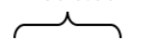

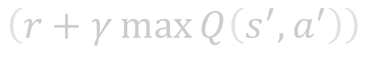
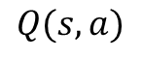
Deep Q Networks (DQN): Training
How can we use deep neural networks to model Q-functions?
Action + State → Expected Return
State → Expected Return for Each Action
$$Q(s,a_{1})$$
Deep
NN
Deep
NN
$$Q(s,a_{2})$$
state, $s$
$$Q(s,a)$$
“move
right”
state, $s$
$$Q(s,a_{n})$$
action, $a$
Input
Agent
Output
Input
Agent
Output
target
predicted
Network
prediction
$$\left(r+γ\max{Q\left(s^{′},a^{′}\right)}\right)$$
$$Q(s, a)$$
$$a^{′}$$

Slide 31
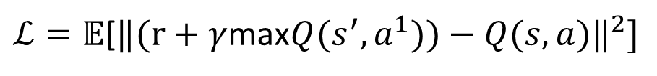
Deep Q Networks (DQN): Training
How can we use deep neural networks to model Q-functions?
Action + State → Expected Return
State → Expected Return for Each Action
$$Q(s,a_{1})$$
Deep
NN
Deep
NN
$$Q(s,a_{2})$$
state, $s$
$$Q(s,a)$$
“move
right”
state, $s$
$$Q(s,a_{n})$$
action, $a$
Input
Agent
Output
Input
Agent
Output
target
predicted
$ℒ=\text{𝔼}\text{[}‖(r+γ$max$Q(s^{′},a^{1}))−Q(s, a)‖^{2}]$
Q-Loss

Slide 32


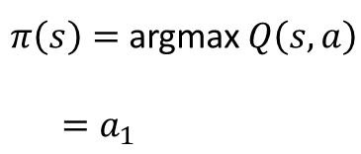
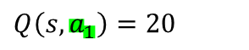
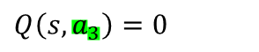
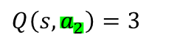
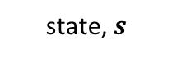
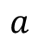
Deep Q Network Summary
Use NN to learn Q-function and then use to infer the optimal policy, $π(s)$
$$Q\left(s,a_{1}\right)=20$$
state, $s$
Deep
NN
$$Q\left(s,a_{2}\right)=3$$
$π\left(s\right)=$ argmax $Q\left(s, a\right)$
$=a_{1}$
$$a$$
$$Q\left(s,a_{3}\right)=0$$
Send action back to environment and receive next state

Slide 33
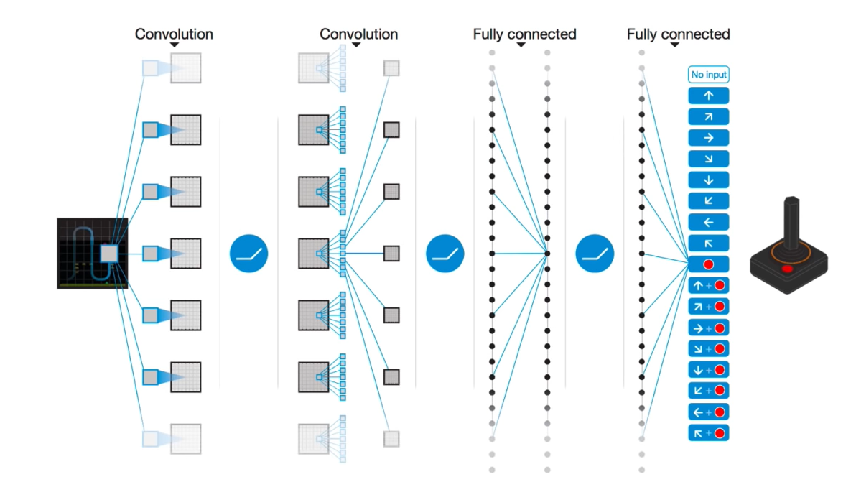
DQN Atari Results
© Alexander Amini and Ava Soleimany MIT 6.S191: Introduction to Deep Learning IntroToDeepLearning.com

Slide 34
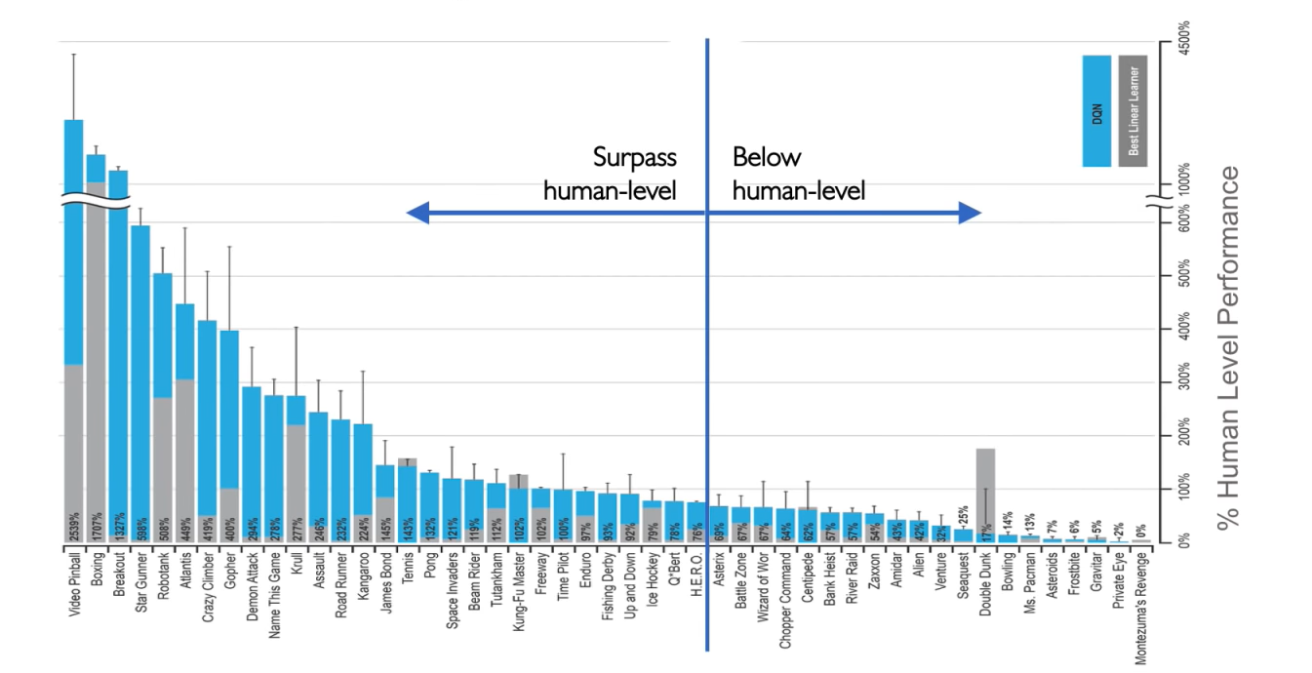
DQN Atari Results

Slide 35
Downsides of Q-learning
Complexity:
Can model scenarios where the action space is discrete and small
Cannot handle continuous action spaces
Flexibility
Policy is deterministically computed from the Q function by maximizing the reward → cannot learn stochastic policies
To address these, consider a new class of RL training algorithms:
Policy gradient methods

Slide 36


Deep Reinforcement Learning Algorithms
Value Learning
Find $Q\left(s, a\right)$
$a=$argmax$Q(s, a)$
$$a$$
Policy Learning
Find $π\left(s\right)$
Sample $a\sim π(s)$

Slide 37
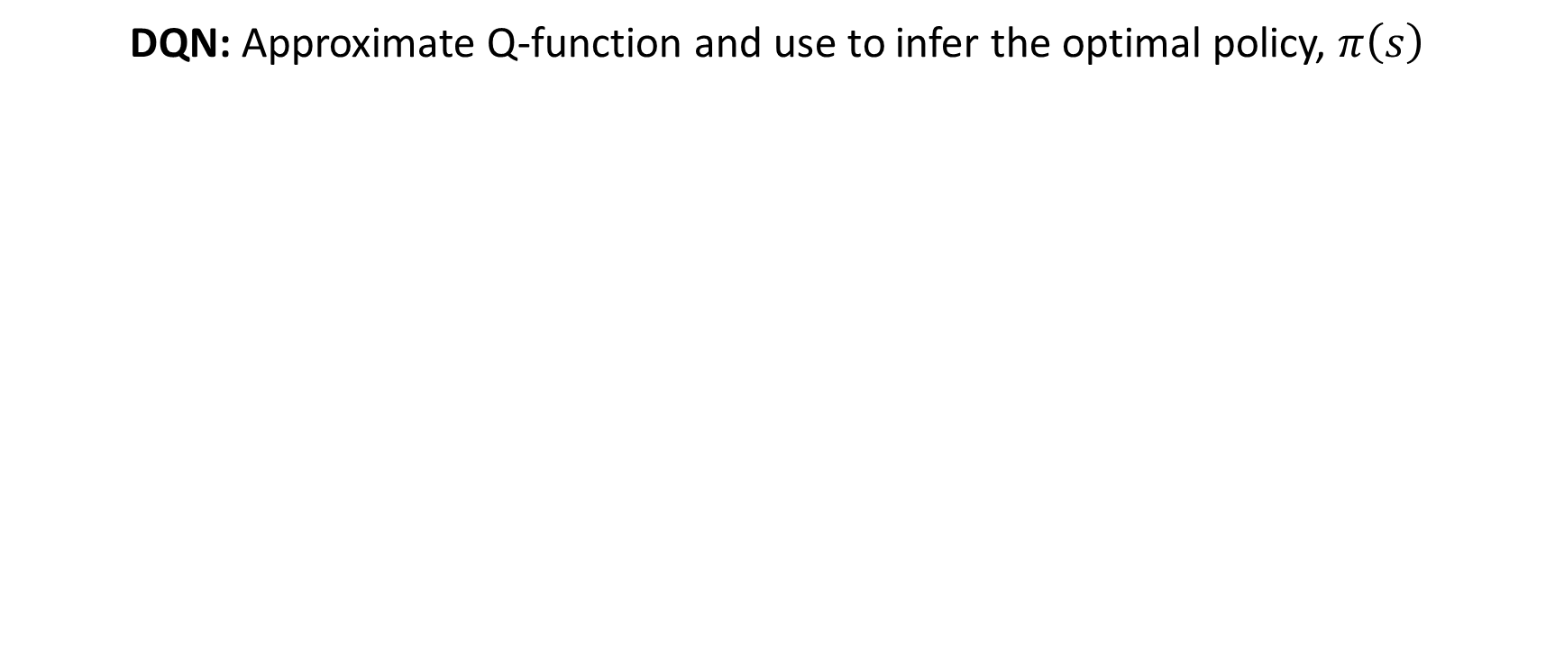
Deep Q Networks (DQN)
DQN: Approximate Q-function and use to infer the optimal policy, $π\left(s\right)$
$$Q\left(s,a_{1}\right)=20$$
state, $s$
Deep
NN
$$Q\left(s,a_{2}\right)=3$$
$π\left(s\right)=$ argmax $Q\left(s, a\right)$
$=a_{1}$
$$a$$
$$Q\left(s,a_{3}\right)=0$$

Slide 38
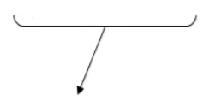
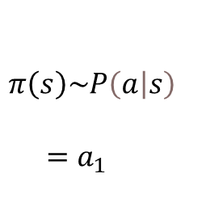
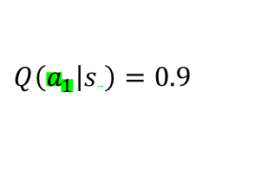
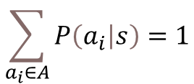
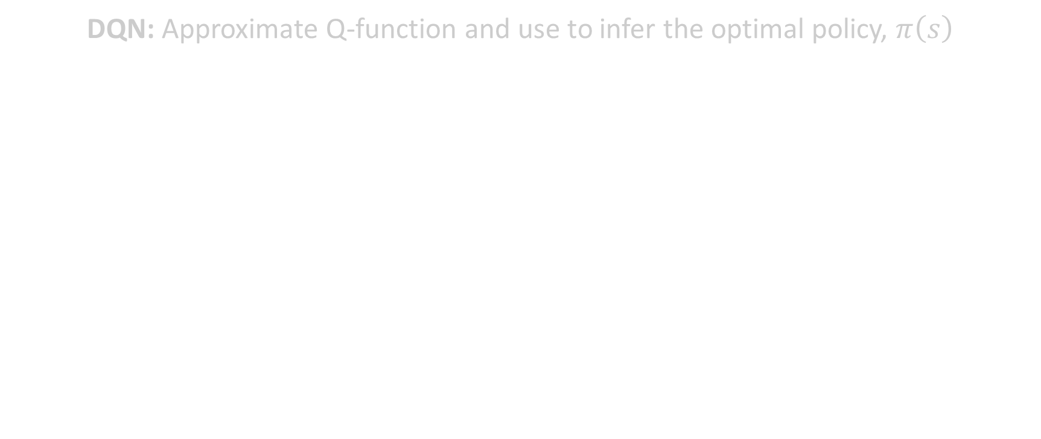
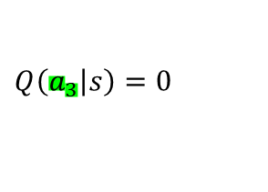
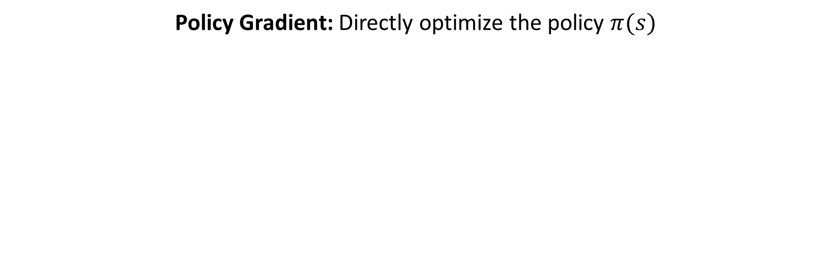
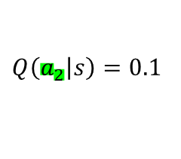
Policy Gradient (PG): Key Idea
DQN: Approximate Q-function and use to infer the optimal policy, $π\left(s\right)$
$$\sum_{a_{i}∈A}{P\left(\left.a_{i}\right|s\right)}=1$$
Policy Gradient: Directly optimize the policy $π(s)$
$$Q\left(\left.a_{1}\right|s \right)=0.9$$
state, $s$
Deep
NN
$$Q\left(\left.a_{2}\right|s\right)=0.1$$
$$π\left(s\right)\sim P\left(\left.a\right|s\right)$$
$=a_{1}$
$$Q\left(\left.a_{3}\right|s\right)=0$$
What are some advantages of this formulation?

Slide 39
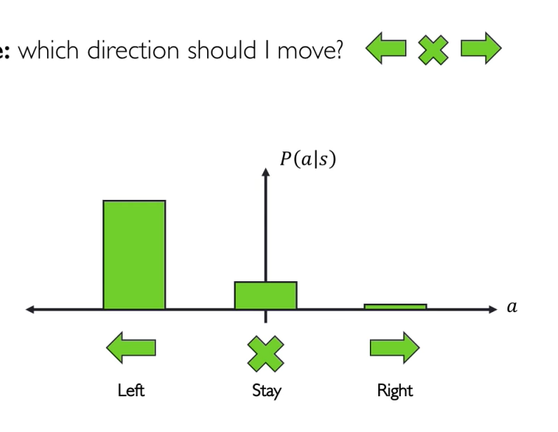

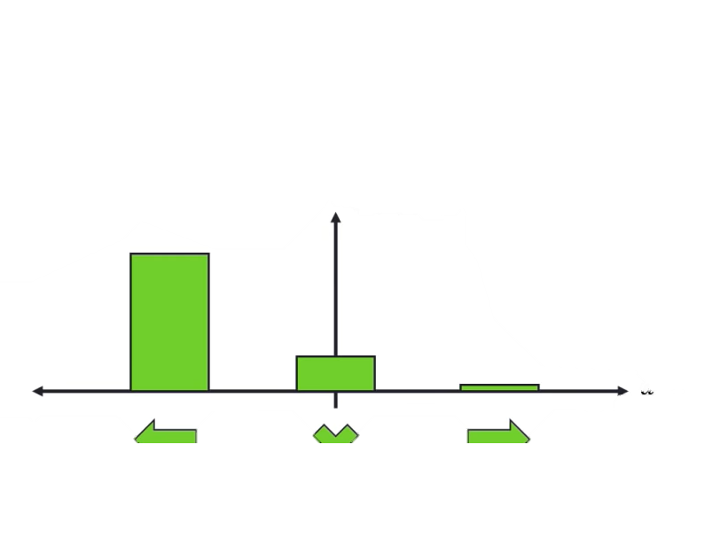
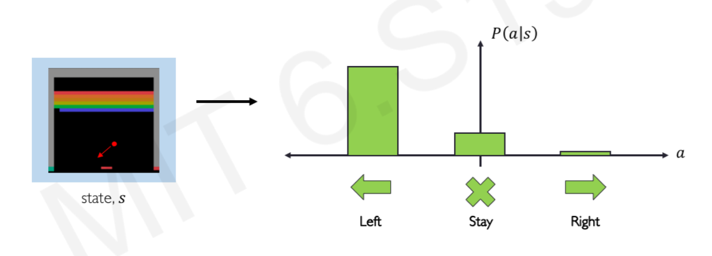
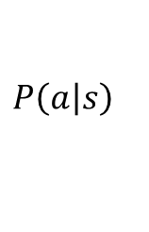


Discrete vs Continuous Action Spaces
Discrete action space: which direction should I move?
$$P\left(\left.a\right|s\right)$$
$$a$$
State, $s$
Left
Stay
Right

Slide 40


Discrete vs Continuous Action Spaces
Discrete action space: which direction should I move?
Continuous action space: how fast should I move?
$$P\left(\left.a\right|s\right)$$
Faster
Left
Faster
Right
State, $s$

Slide 41








Policy Gradient (PG): Key Idea
Policy Gradient: Enables modeling of continuous action space
$$\int_{a=−∞}^{∞}{P(a\left|s)=1\right.}$$
Mean, $μ=−1$
Deep
NN
$$P(a\left|s)=N(μ,σ^{2})\right.$$
$$π\left(s\right)\sim P\left(a\left|s\right.\right)$$
$$=−0.8[m/s]$$
Variance, $σ^{2}=0.5$
State, $s$

Slide 42


Training Policy Gradients: Case Study
Reinforcement Learning Loop:
State changes: $S_{t+1}$
Reward: $r_{t}$
Action: $a_{t}$
Case Study – Self-Driving Cars
Agent: vehicle
State: camera, lidar, etc
Action: steering wheel angle
Reward: distance traveled
OBSERVATIONS
ACTIONS

Slide 43

Training Policy Gradients
Training Algorithm
Initialize the agent
Run a policy until termination
Record all states, actions, rewards
Decrease probability of actions that resulted in low reward
Increase probability of actions that resulted in high reward

Slide 44

Training Policy Gradients
Training Algorithm
Initialize the agent
Run a policy until termination
Record all states, actions, rewards
Decrease probability of actions that resulted in low reward
Increase probability of actions that resulted in high reward

Slide 45

Training Policy Gradients
Training Algorithm
Initialize the agent
Run a policy until termination
Record all states, actions, rewards
Decrease probability of actions that resulted in low reward
Increase probability of actions that resulted in high reward

Slide 46


Training Policy Gradients
Training Algorithm
Initialize the agent
Run a policy until termination
Record all states, actions, rewards
Decrease probability of actions that resulted in low reward
Increase probability of actions that resulted in high reward

Slide 47

Training Policy Gradients
Log-likelihood of action
Training Algorithm
Initialize the agent
Run a policy until termination
Record all states, actions, rewards
Decrease probability of actions that resulted in low reward
Increase probability of actions that resulted in high reward
loss = $−\log{P(a_{t}\left|s_{t}\right.)R_{t}}$
Gradient descent update:
$$w’ = w−∇loss$$
$$w’ = w+∇\log{P(a_{t}\left|s_{t})R_{t}\right.}$$
reward
Policy gradient

Slide 48

Reinforcement Learning in Real Life
Training Algorithm
Initialize the agent
Run a policy until termination
Record all states, actions, rewards
Decrease probability of actions that resulted in low reward
Increase probability of actions that resulted in high reward

Slide 49

Data-driven Simulation for Autonomous Vehicles
VISTA: Photorealistic and high-fidelity simulator for training and testing self-driving cars

Slide 50


Deploying End-to-End RL for Autonomous Vehicles
Policy Gradient RL agent trained entirely within VISTA simulator
End-to-end agent directly deployed into the real-world
First full-scale autonomous vehicle training using RL entirely in simulation and deployed in real life

Slide 51
Deep Reinforcement Learning Applications

Slide 52

Reinforcement Learning and the Game of Go

Slide 53


The Game of Go
Aim: Get more board territory than your opponent.
Board size n x n | Positions $3^{n^{2}}$ | % Legal | Legal Positions
1 x 1 | 3 | 33.33% | 1
2 x 2 | 81 | 70.37% | 57
3 x 3 | 19,683 | 64.40% | 12,675
4 x 4 | 43,046,721 | 56.49% | 24,318,165
5 x 5 | 847,288,609,443 | 48.90% | 414,295,148,741
9 x 9 | 4.434264882$×{10}^{38}$ | 23.44% | 1.0391945761$×{10}^{38}$
13 x 13 | 4.300233593$×{10}^{80}$ | 8.66% | 3.72497923077$×{10}^{79}$
19 x 19 | 1.740896506$×{10}^{172}$ | 1.20% | 2.08168199382$×{10}^{170}$
Greater number of legal board positions than atoms in the universe

Slide 54

AlphaGo Beats Top Human Player at Go (2016)
Human expert positions
Supervised Learning policy network
RL
Policy network
Self-play data
Value Network
Classification
Regression
Self
Play
Self
Play

Slide 55
AlphaGo Beats Top Human Player at Go (2016)
Human expert positions
Supervised Learning policy network
RL
Policy network
Self-play data
Value Network
Classification
Regression
Self
Play
Self
Play
1) Initial training: human data

Slide 56
AlphaGo Beats Top Human Player at Go (2016)
Human expert positions
Supervised Learning policy network
RL
Policy network
Self-play data
Value Network
Classification
Regression
Self
Play
Self
Play
1) Initial training: human data
2) Self-play and reinforcement learning
→ super-human performance

Slide 57

AlphaGo Beats Top Human Player at Go (2016)
Human expert positions
Supervised Learning policy network
RL
Policy network
Self-play data
Value Network
Classification
Regression
Self
Play
Self
Play
1) Initial training: human data
2) Self-play and reinforcement learning
→ super-human performance
3) “Intuition” about board state

Slide 58

AlphaZero: RL from Self-Play (2018)

Slide 59

Deep Reinforcement Learning: Summary
Foundations
Q-Learning
Policy Gradients
Agents acting in environment
State-action pairs → maximize future rewards
Discounting
Q function: expected total reward given s, a
Policy determined by selecting action that maximizes Q function
Learn and optimize the policy directly
Applicable to continuous action spaces
© Alexander Amini and Ava Soleimany MIT 6.S191: Introduction to Deep Learning IntroToDeepLearning.com

